Slide 1
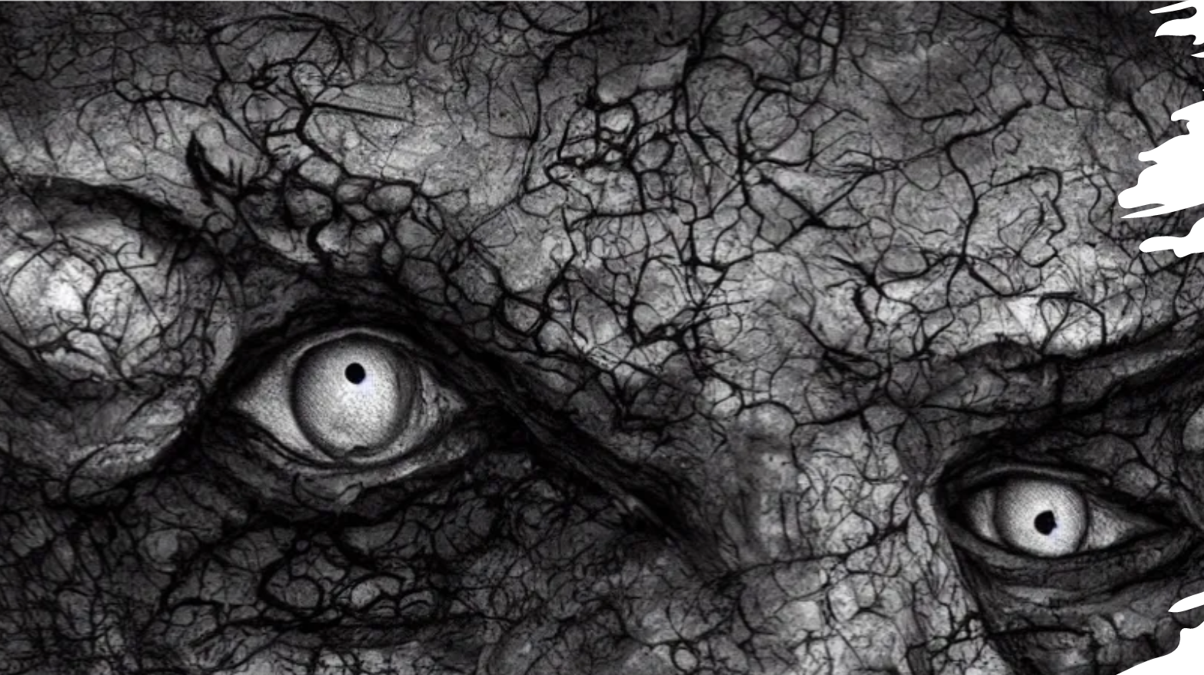
Transcendent Echoes
Luis E. Rodríguez Reyes

Slide 2
About me

Slide 3

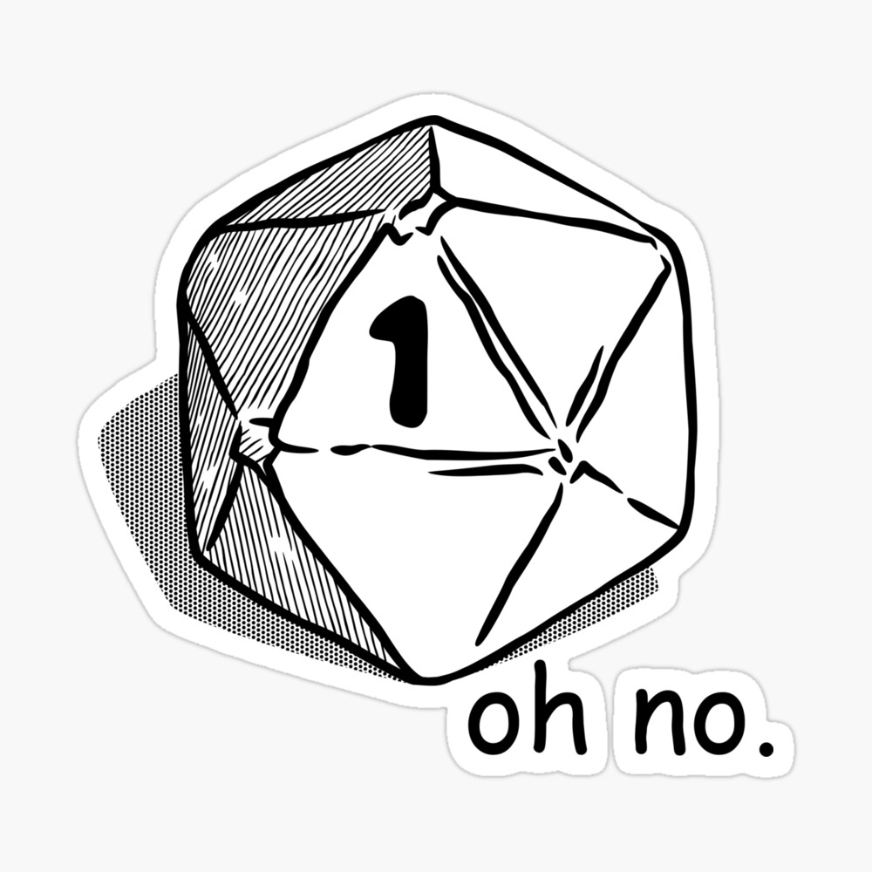
Here’s my Pitch
DnD adventure
Survive and beware mobs!
Y? It’s my love shoutout!

Slide 4
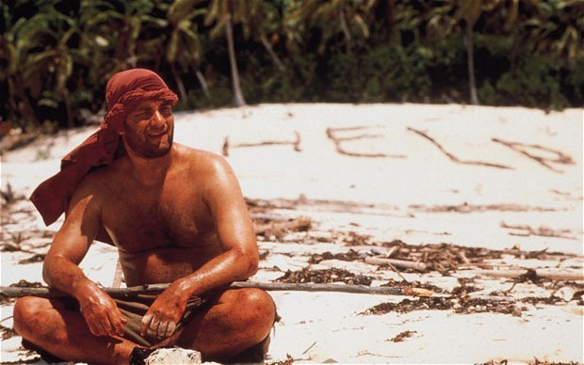

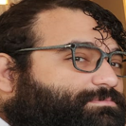
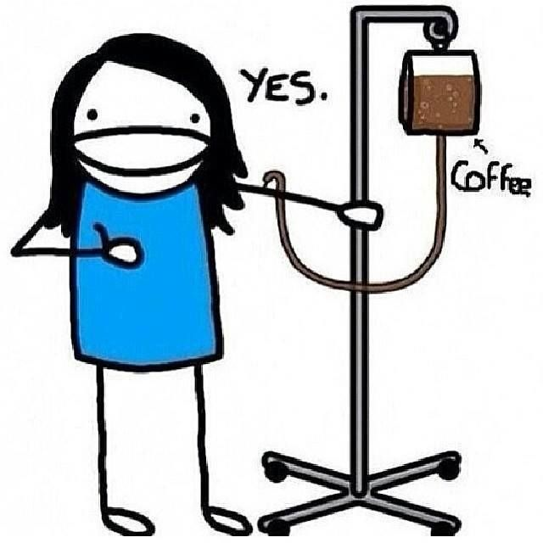
My struggle...
Technical
Clases, constructors..
Making my story flow!

Slide 5
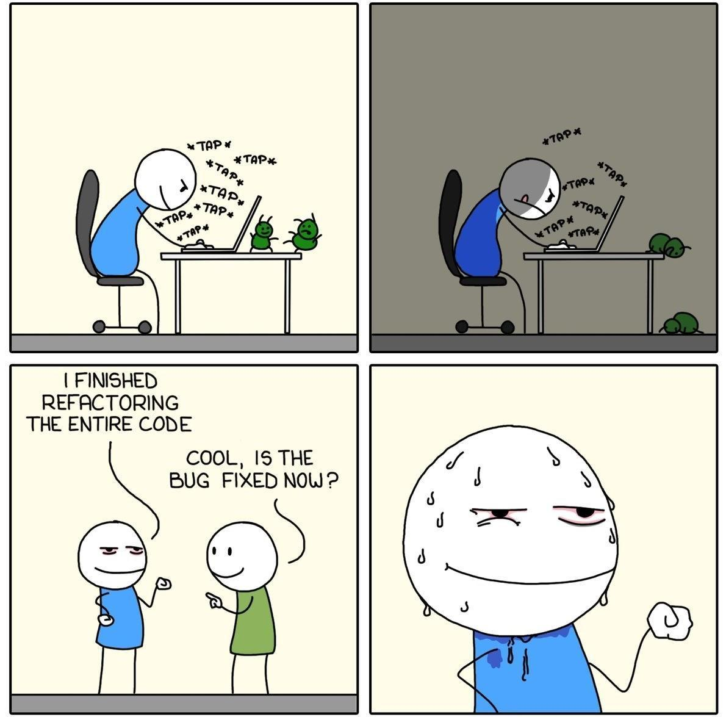
Biggest mistake…
Coding in incomplete snippets
Stuck---> Drop --->Next issue --->Drop.
How do they all go back together again?
The fix:
REFACTOR and Daniel, and Dustin!
< --- me in the stand ups!

Slide 6
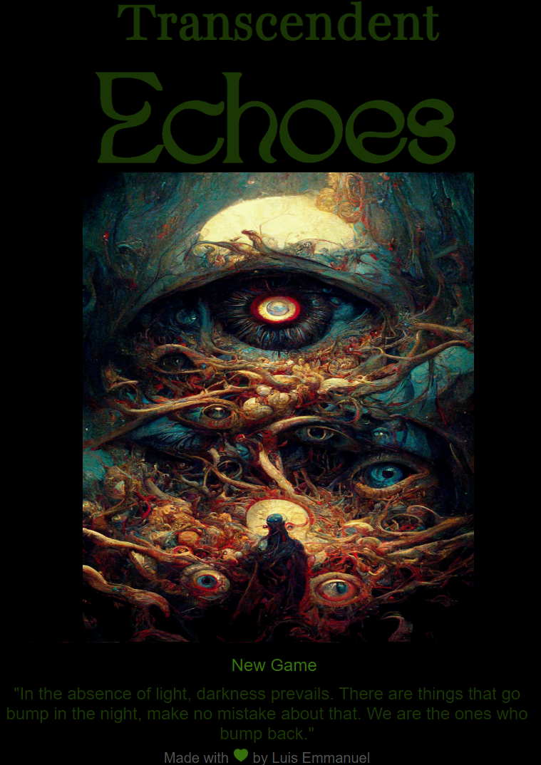

Thanks guys!
Repo: https://github.com/lerodriguezreyes/m1p-echoes
Link to game:
https://lerodriguezreyes.github.io/m1p-echoes/

